Slide 1
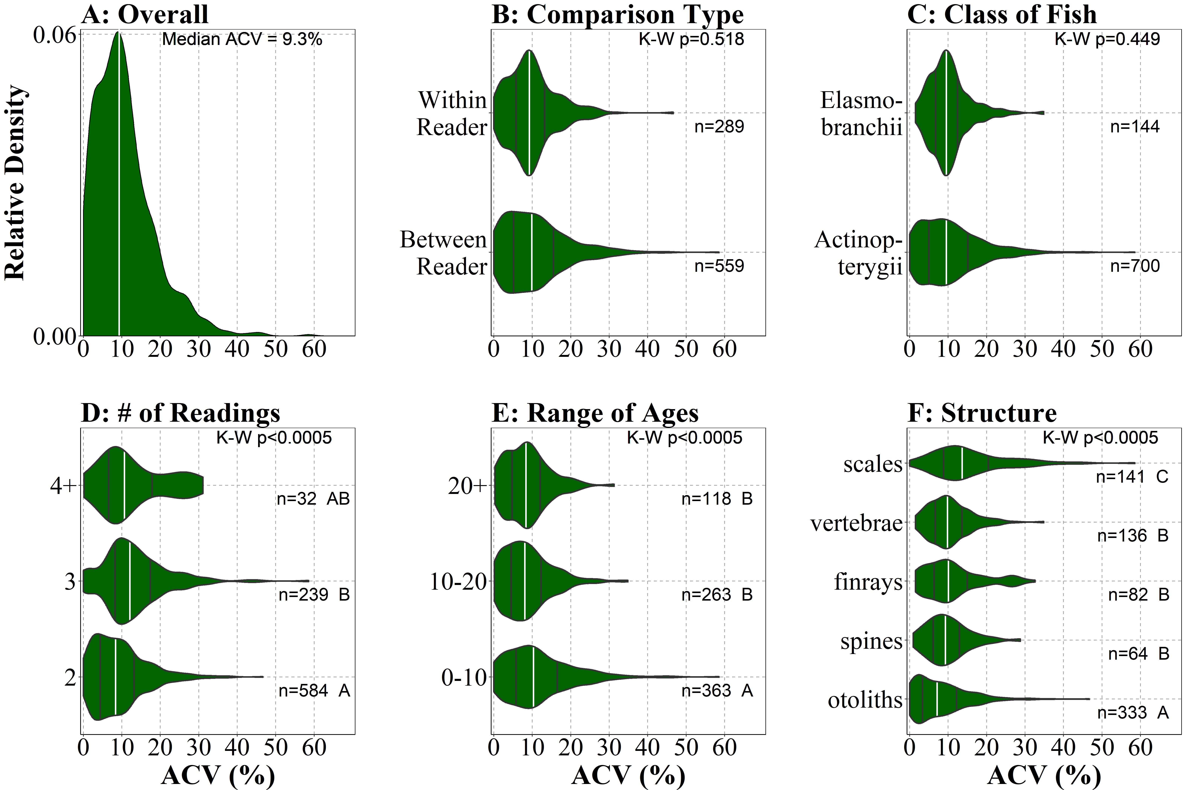
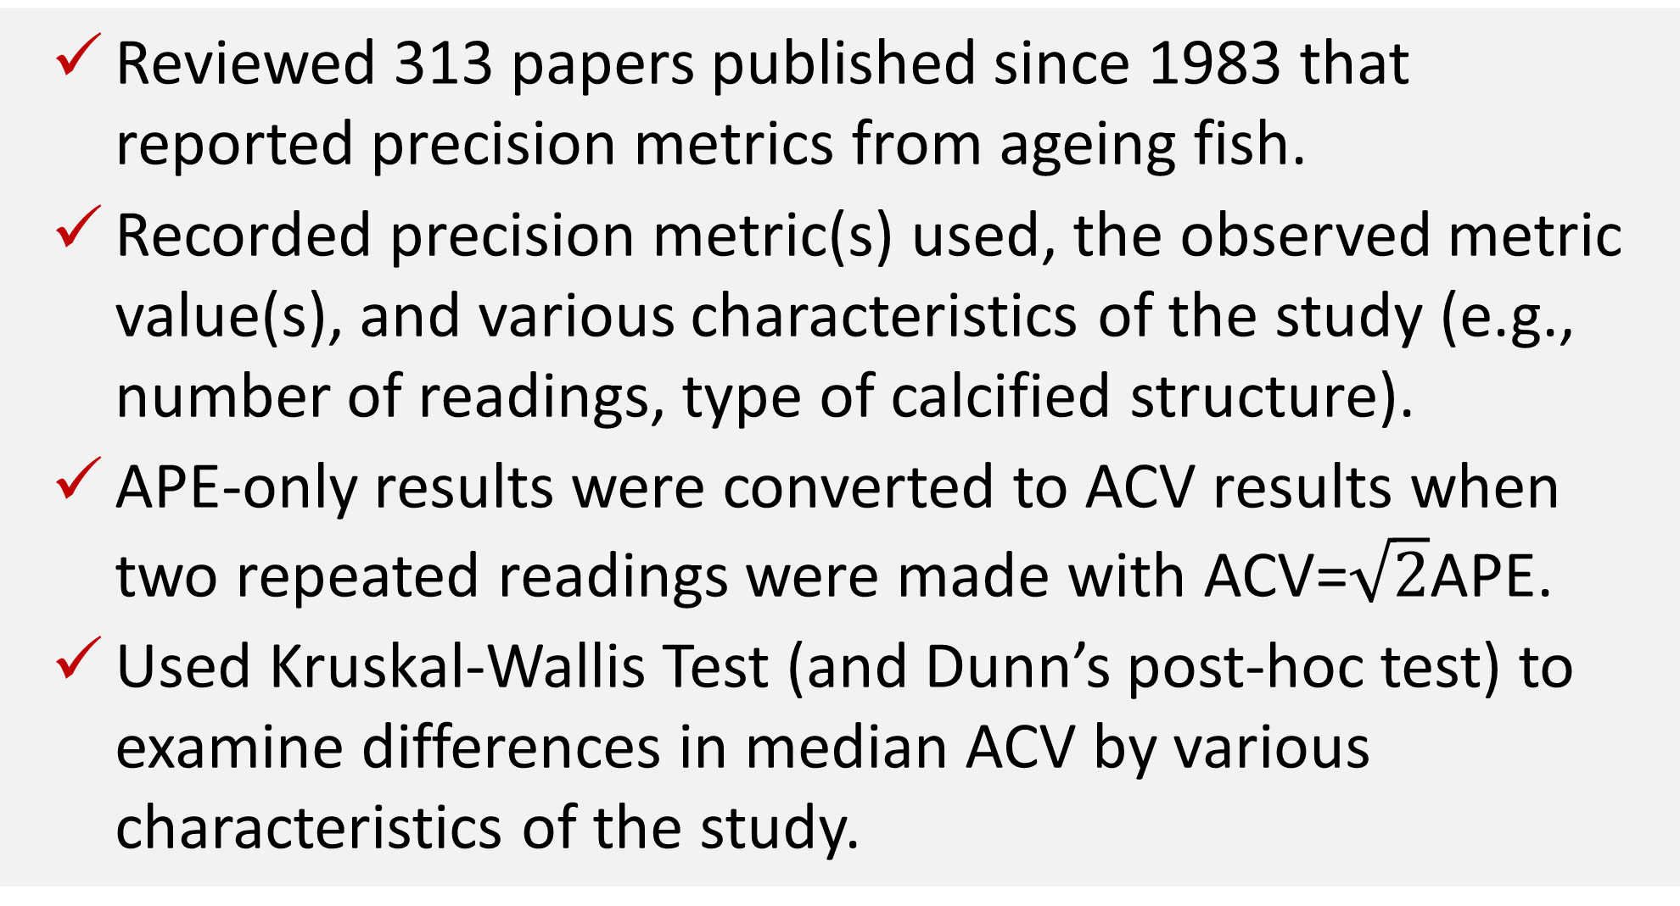
Precision Metrics Summarized from 20+ years of Fish Age Estimation Studies
Joshua F. Lyons and Derek H. Ogle • Northland College
Background
Results
Age estimation of fish is crucial for the assessment of fish population dynamics and stock structure.
Precision is the repeatability of age estimates among multiple readings of the same calcified structures.
Common measures of precision are percent agreement, average percent error (APE), and average coefficient of variation (ACV).
Campana (2001; J. Fish Biol. 59:197-242) reviewed the use of precision measures in the fisheries literature.
Suggested using ACV in most cases.
Reported a modal observed ACV of 5%.
Two-thirds of reviewed papers published after 2001 used an ACV to measure precision.
The distribution of ACV was right-skewed with a median of 9.3% and a mode of 9-10% (Fig. A).
Median ACV did not differ between between-reader and within-reader comparisons (Fig. B), or between Actinopterygii and Elasmobranchii classes (Fig. C).
Median ACV for 2 repeated readings was significantly lower that median ACV for 3 repeated readings, but statistically the same for more than 4 repeated readings (Fig. D).
Median ACV for results with 0-10 observed ages was significantly higher than the median ACV for results with 10-20 and more than 20 observed ages (Fig. E).
Median ACV for results using otoliths was significantly lower than the median ACV for spines, finrays, and vertebrae, which all had a median ACV lower that the median ACV for scales (Fig. F).
Objectives
Figures. Density of observed ACV values for all studies (A) and by comparison type (B), class of fish (C), number of repeated readings (D), range of observed ages (E), and type of calcified structure (F). Vertical white lines are the median, whereas vertical black lines are Q1 and Q3. The Kruskal-Wallis (K-W) p-values and group sample sizes (n) are shown. Groups with different letters have significantly different median ACVs.
Determine if papers since Campana (2001) primarily used the ACV.
Assess if the modal observed ACV value reported by Campana (2001) has changed in recent studies.
Determine if ACV is affected by type of comparison, class of fish, number of readings, range of observed ages, and type of calcified structure.
Methods
Reviewed 313 papers published since 1983 that reported precision metrics from ageing fish.
Recorded precision metric(s) used, the observed metric value(s), and various characteristics of the study (e.g., number of readings, type of calcified structure).
APE-only results were converted to ACV results when two repeated readings were made with ACV=$\sqrt{2}$APE.
Used Kruskal-Wallis Test (and Dunn’s post-hoc test) to examine differences in median ACV by various characteristics of the study.
Conclusions &
Management Implications
Most, but not all, studies since 2001 used the ACV as a precision metric as suggested by Campana (2001).
Overall, ACV is higher than that reported by Campana (2001). This may be due to more published age precision studies using more calcified structures and more inexperienced readers.
Variability in ACV is explained by aspects of the analysis; e.g., number of repeated readings, range of ages, structure type.
Our results will allow for more specific and nuanced comparisons for future studies.

